Slide 1



Slide 2
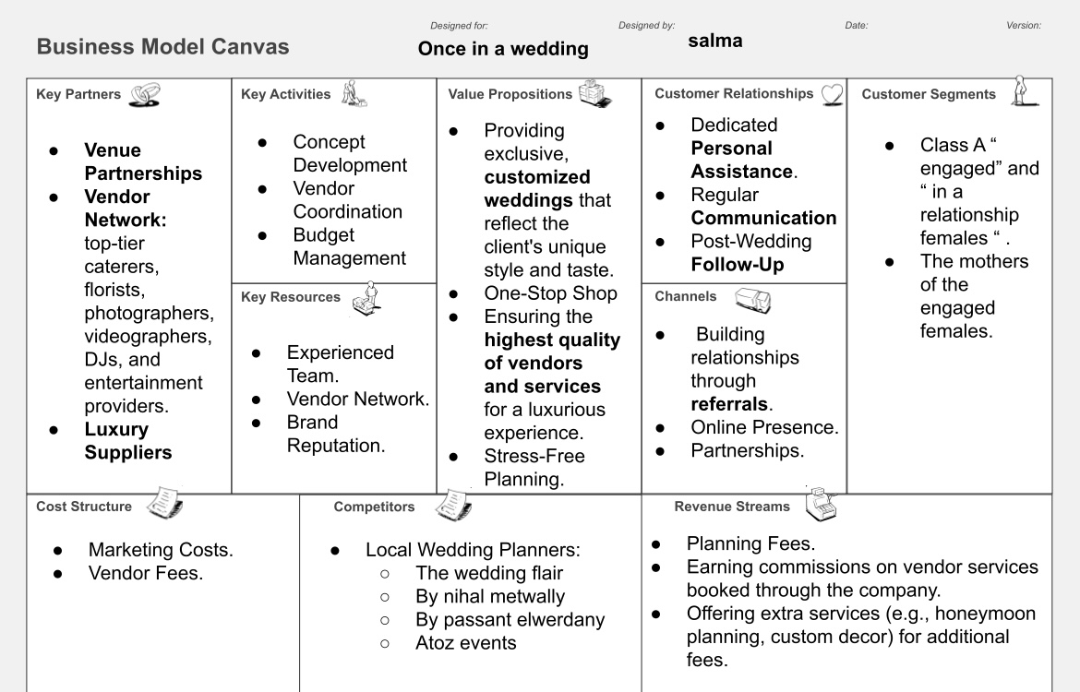

Slide 3





SWOT Analysis
SMART Objectives
Strategy
Index
Value Proposition
7 CS
Calendar

Slide 4



SWOT
ANALYSIS

Slide 5


Strength
Weakness
we don’t post on time
We don’t post consistently
We want to have a social media presence
We don’t have a team
We have another job, so we’re not able to give it our 100%
We target a specific niche
High quality pictures
High quality materials
We offer everything venue suggestions, decorations, DJ, photographers videographers, & catering suggestions
Customized packages
Members of our team have experience
Opportunities
Threats
Expand social media presence
% of people getting engaged / married in Egypt is 800k per year
Culture of collaborations with venues, photographers is more popular
Trends in weddings that people want to copy
Hotels getting expensive so people would go more to open air weddings
A lot of competitors,
Legal threats
The inflation, and petrol price changes
Devaluation of the Egyptian currency
Drops with suppliers can happen
Culture of accepting a wedding planner instead of a hotel

Slide 6

SMART
OBJECTIVES

Slide 7

•Book 100 clients between October 2024 and October 2025.
•Make 1 million profit between October 2024 & October 2025
•Post twice a week on Instagram & Facebook
•Gain 50,000 followers between October 2024 & October 2025 on Instagram
•Hire a content creator by the end of 2024

Slide 8
Strategy

Slide 9
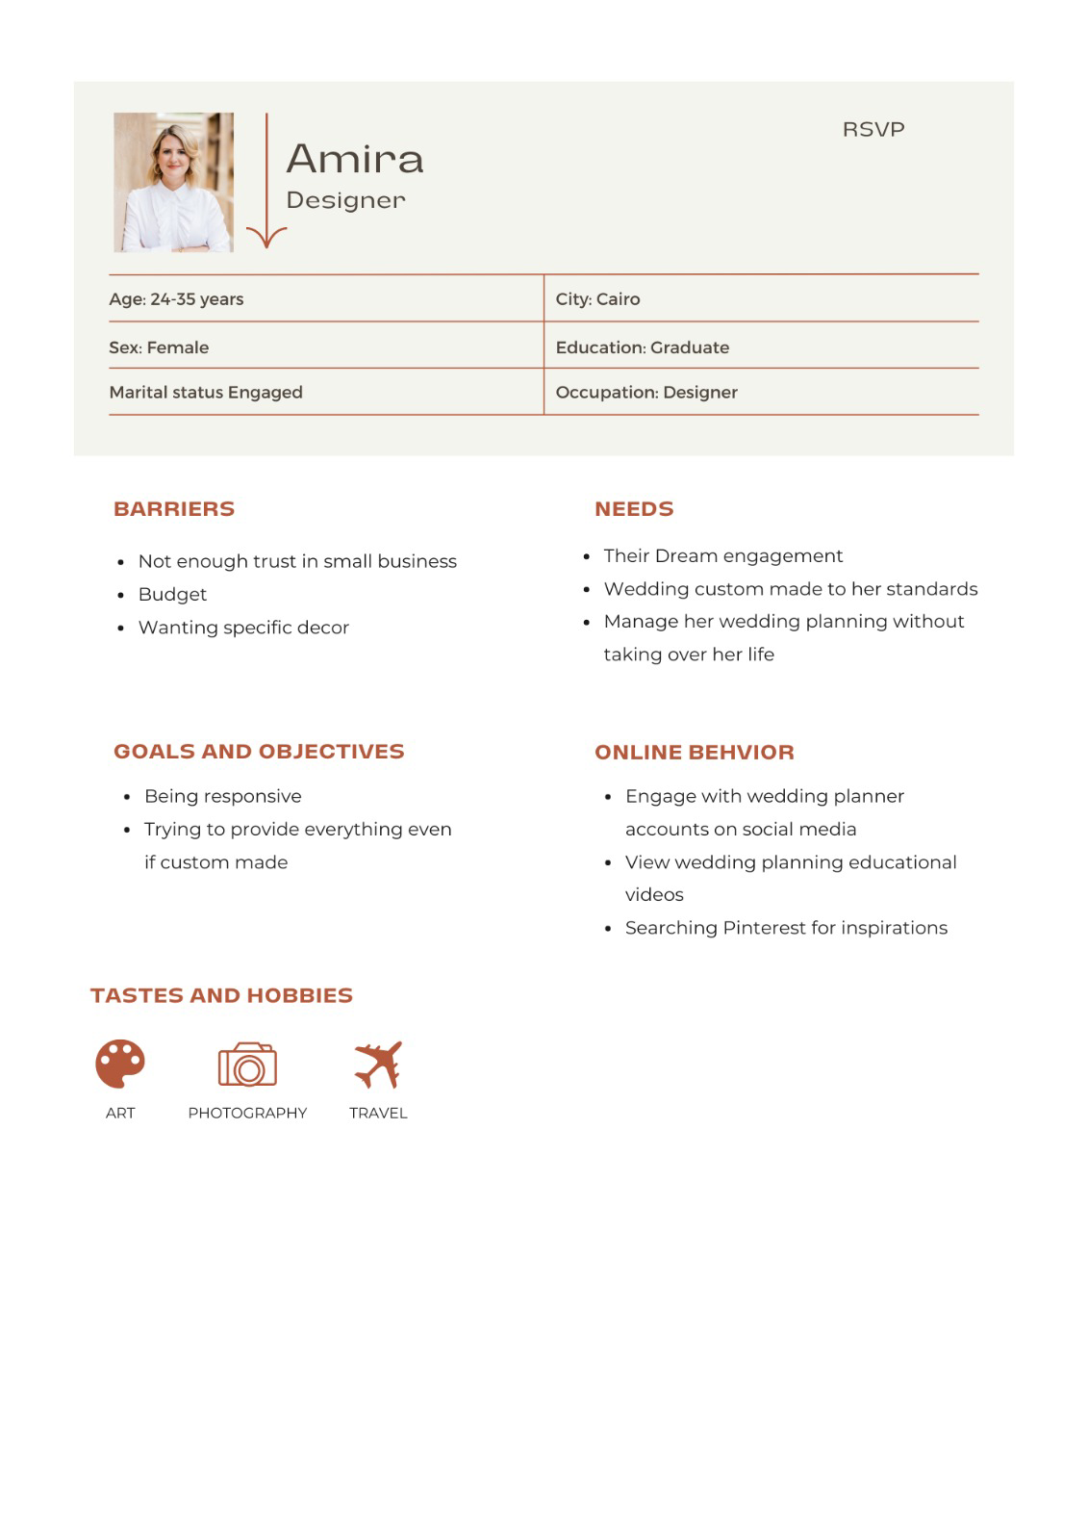
BUYER PERSONA
(bride)

Slide 10
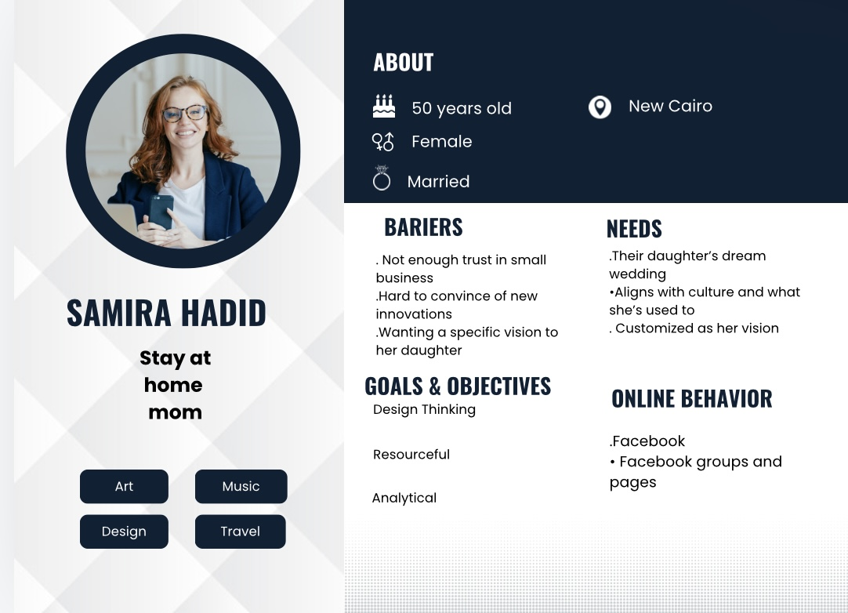
BUYER PERSONA
(Bride’s mother)

Slide 11
VALUE PROPOSITION
Ready to have an exceptional once in a lifetime experience?
We Once In A Wedding help brides to bring their vision to life!
You can customize your wedding from home without any physical interaction from your side.
Send us your Pinterest mood-board and we’ll take care of the rest.

Slide 12
7 CS
Customer Profile: engaged or in a relationship females
Cost Strategy: adding 15% as a profit over the cost
Convenience: provide stress-free experience
Communication: Instagram & Facebook
Credibility: Testimonials

Slide 13
Customer Service: Our response time is within 5 minutes
Connection: We collaborate with event venues

Slide 14
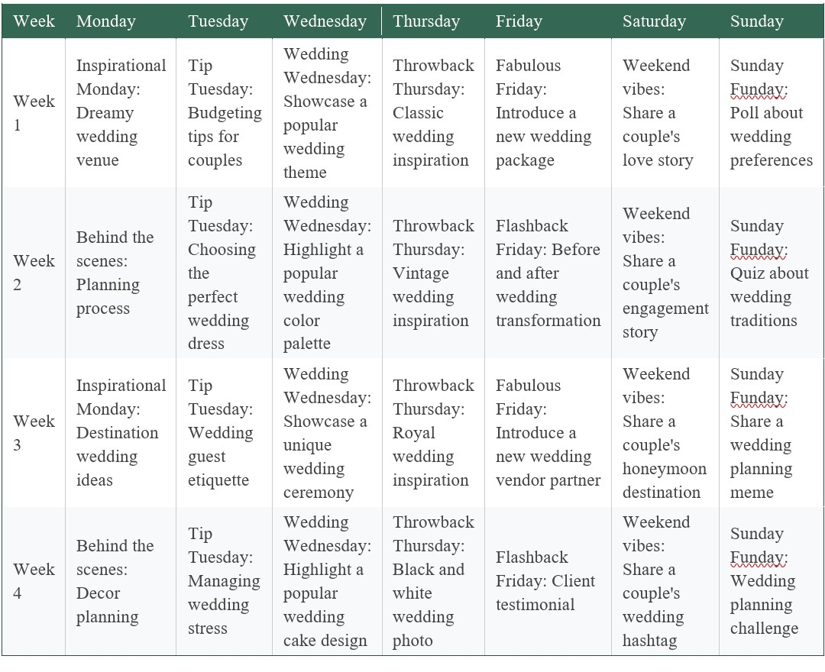
 |  |  | \
 |  |  | \
 |  |  | \
 |  |  | \
 |  |  | \
CALENDAR

Slide 15

Contact Us
Instagram: once.inawedding
Facebook: once in a wedding

Slide 16

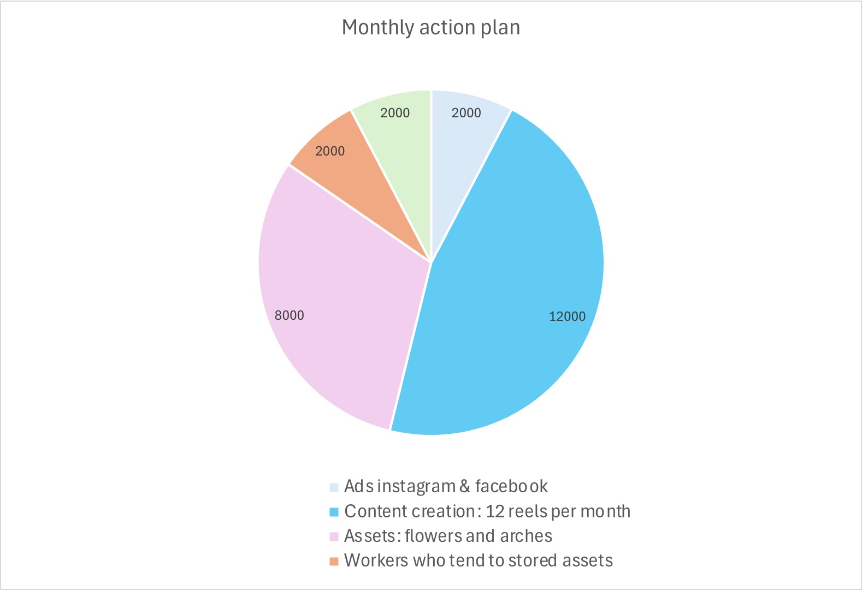
Action Plan

Slide 17
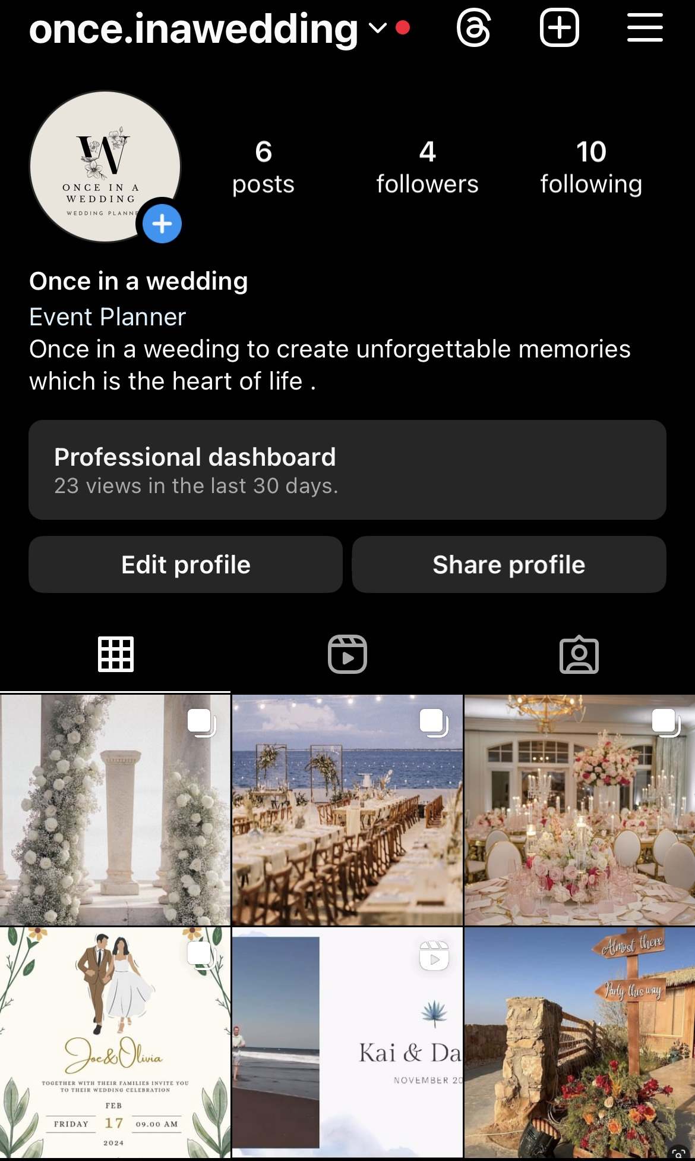
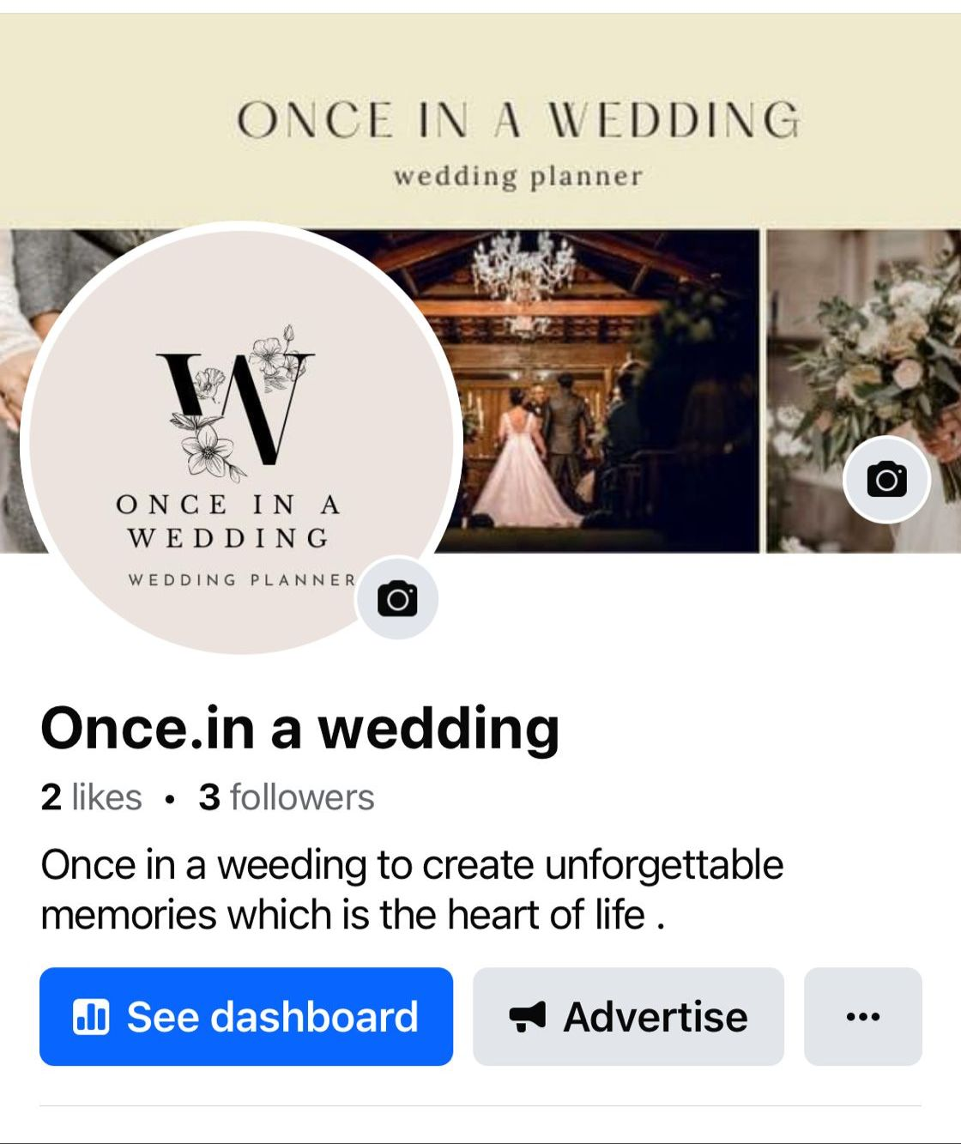
Pages

Slide 18
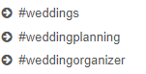
Keyword planning
Hashtags Planning
Words Planning

Slide 19
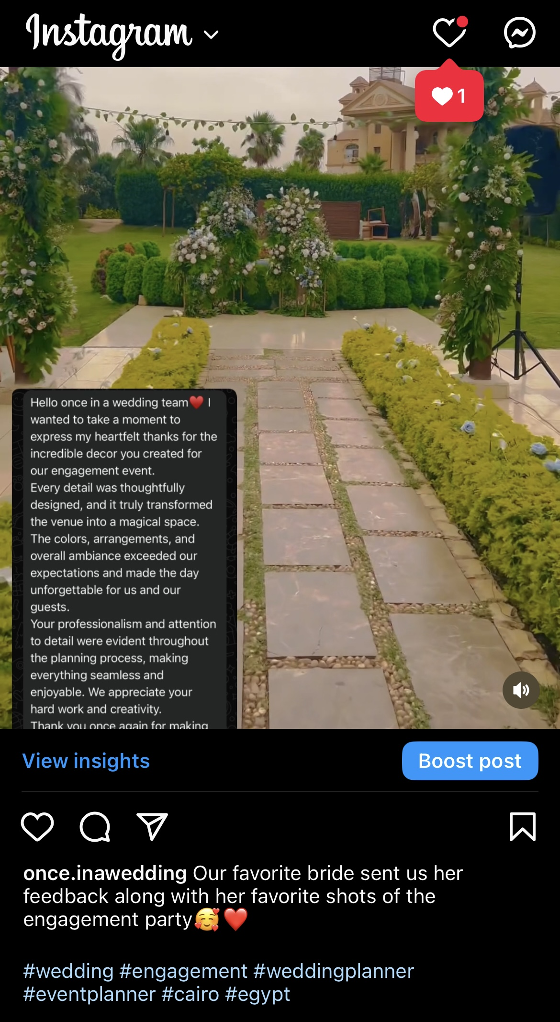
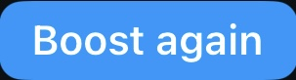
Posts: UGC (User generated content)

Slide 20
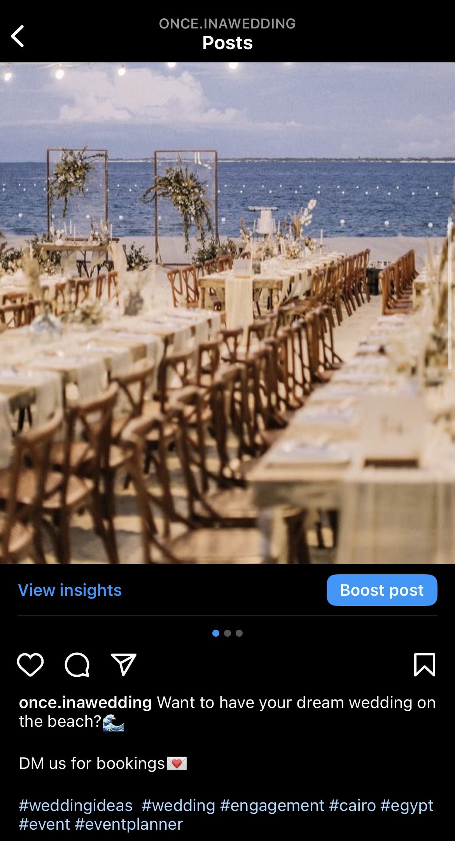
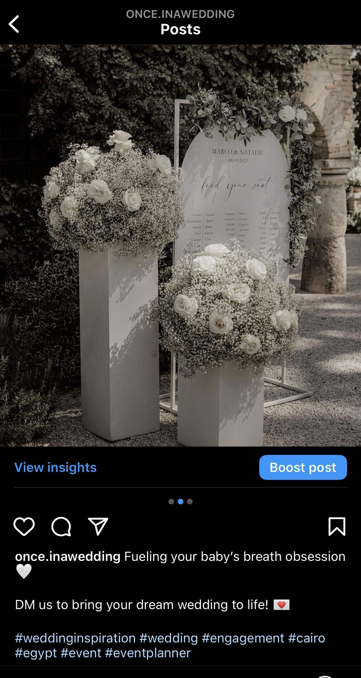
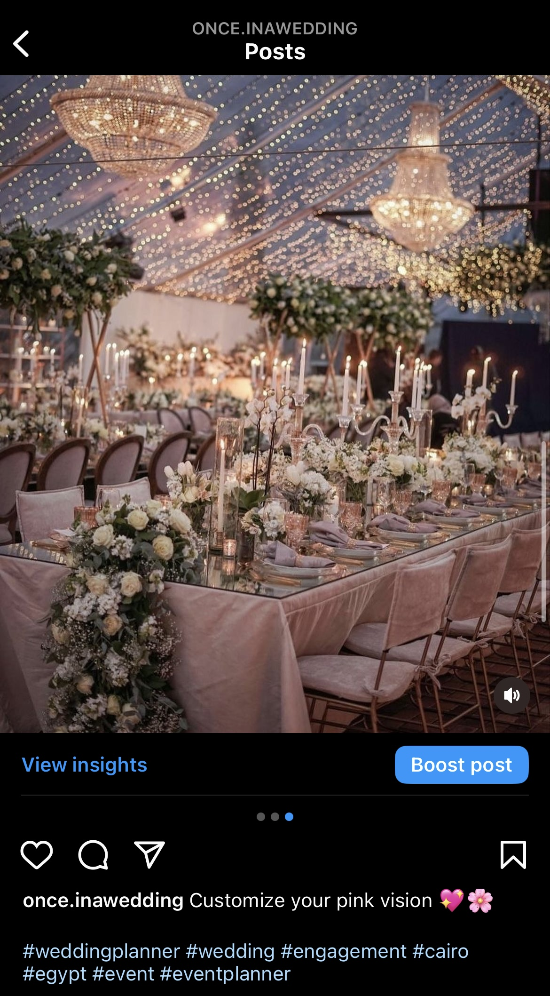
Posts: mood-boards

Slide 21
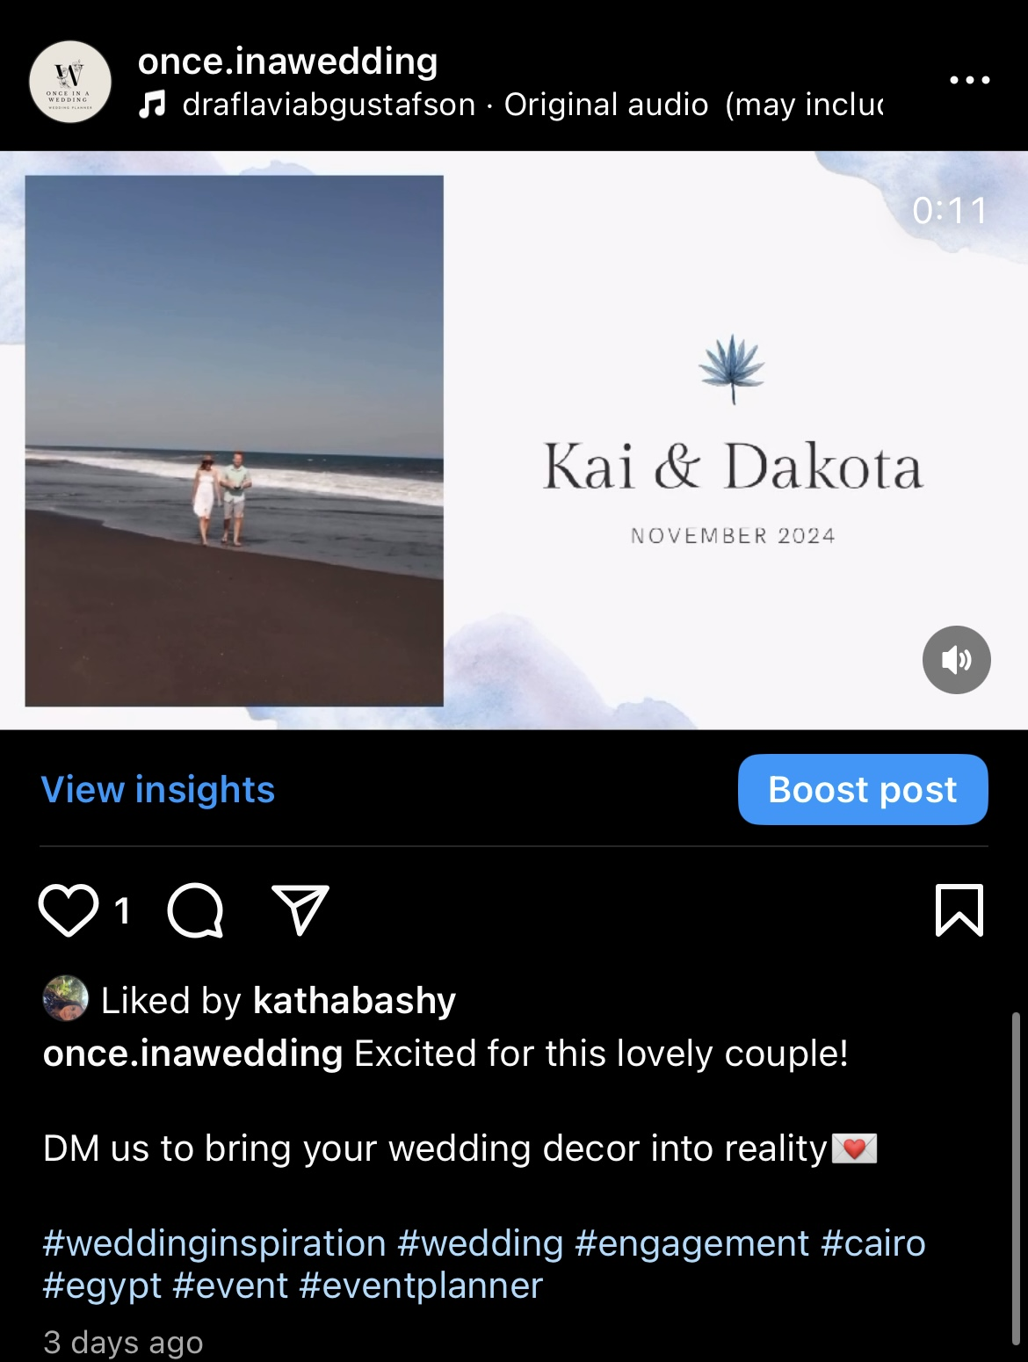
Posts: reels (teaser for upcoming events)

Slide 22
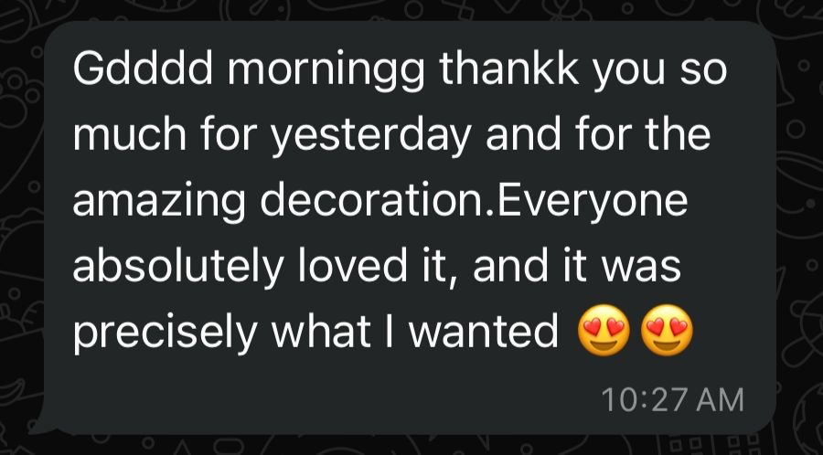
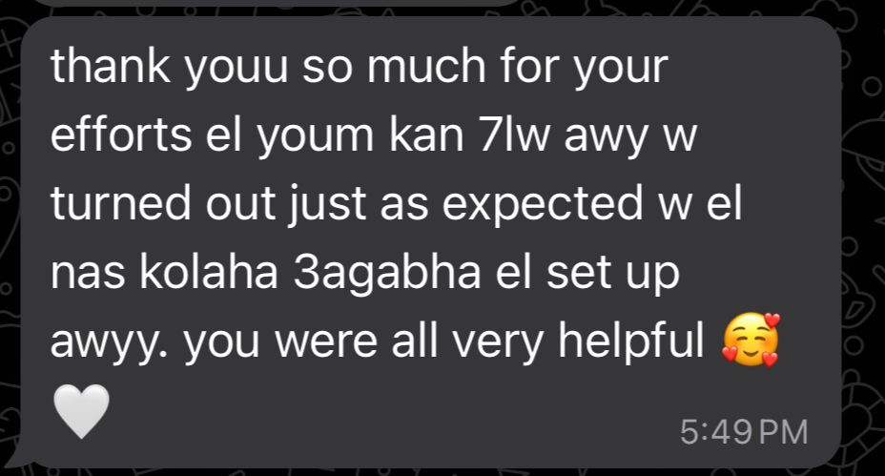
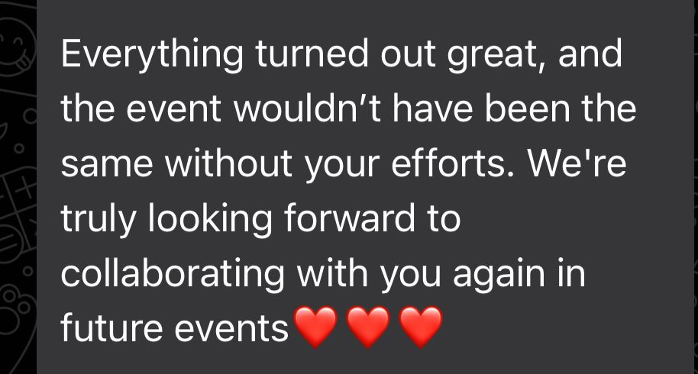
Testimonials

Slide 23
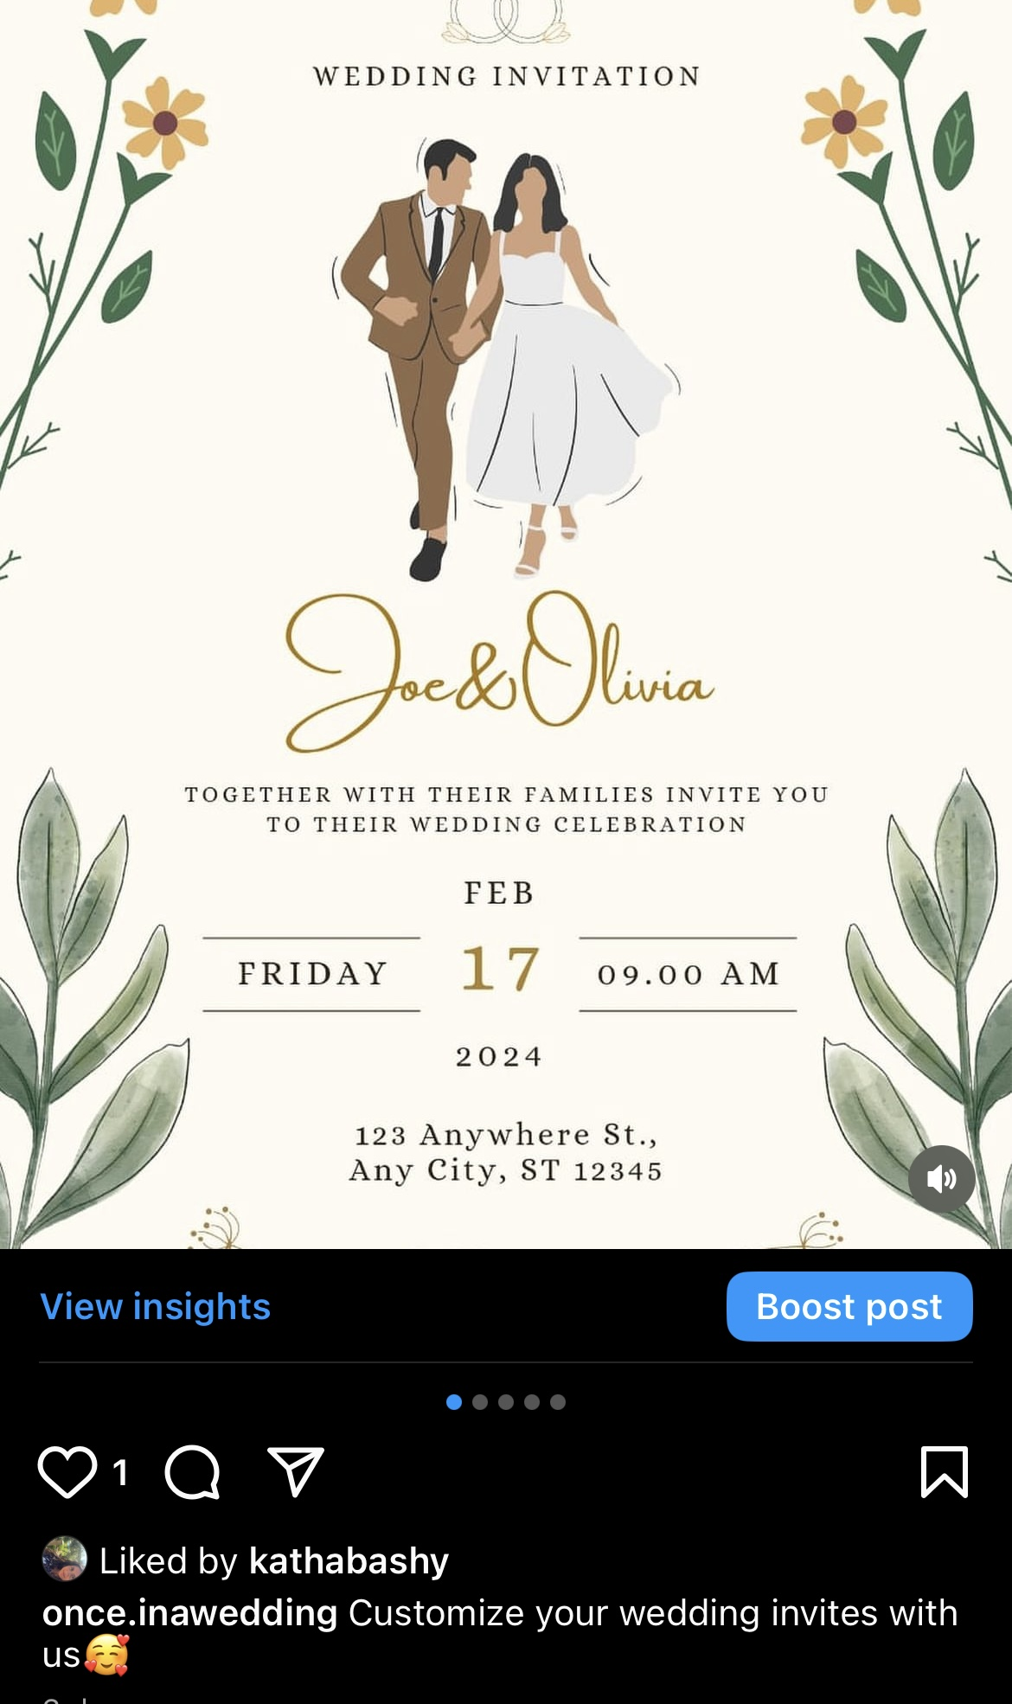
Posts: wedding invitation service

Slide 24
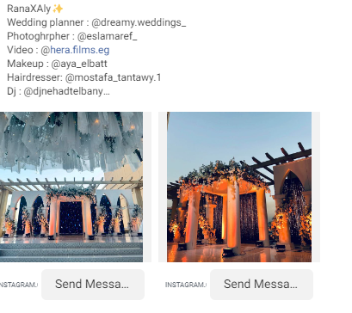
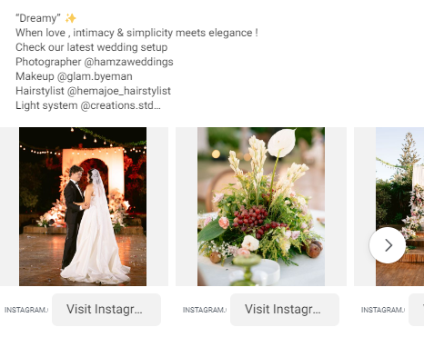
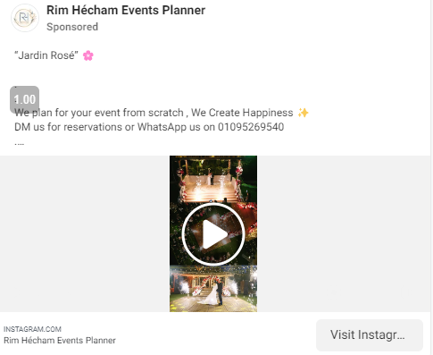
Competitors Ads analysis

Slide 25
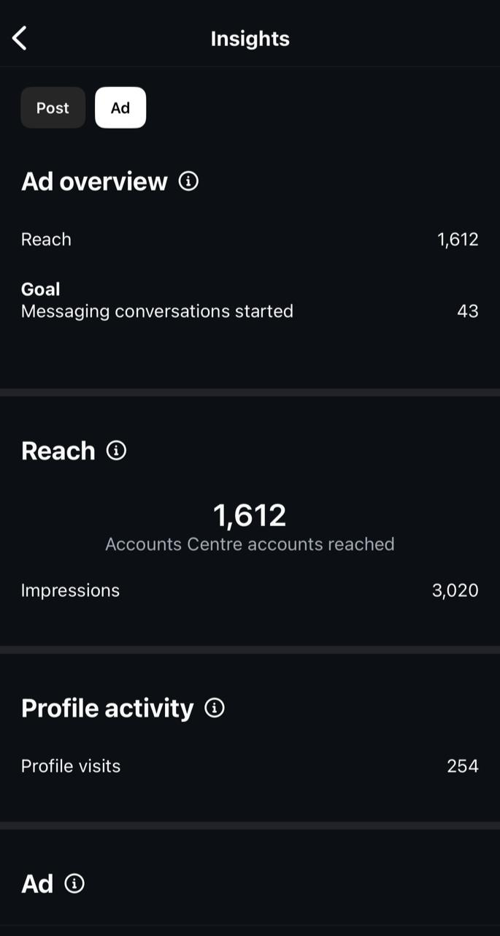
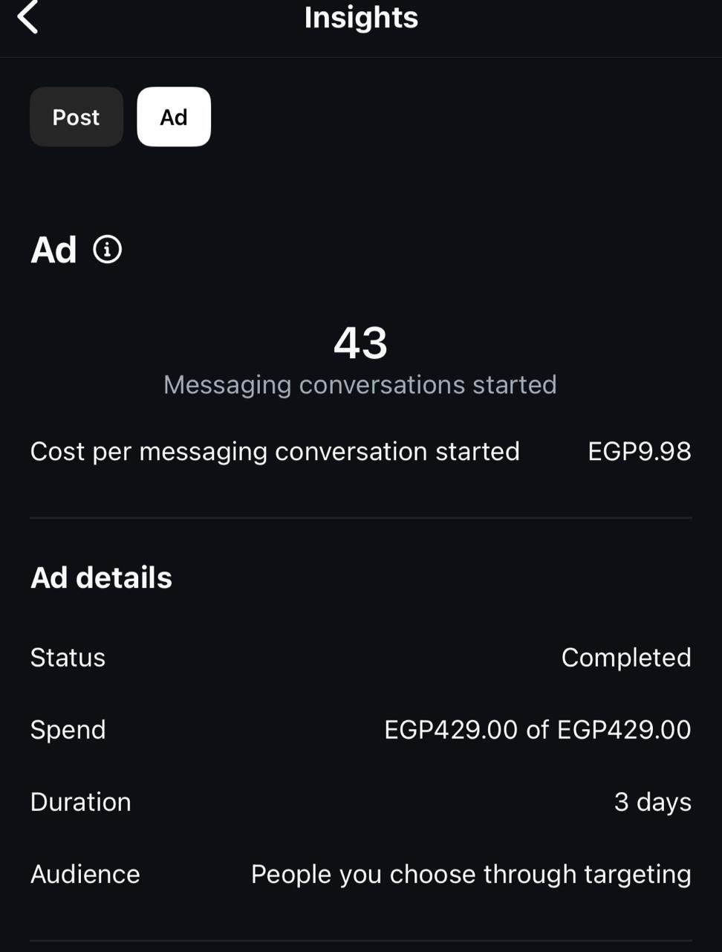
Ads

Slide 26
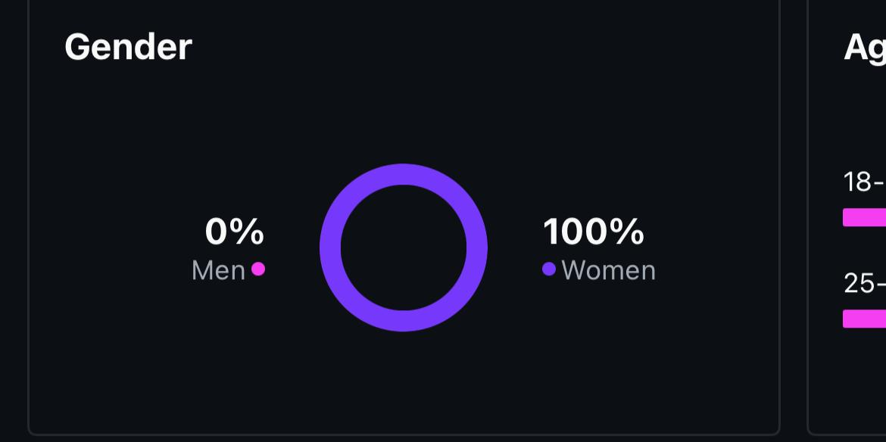
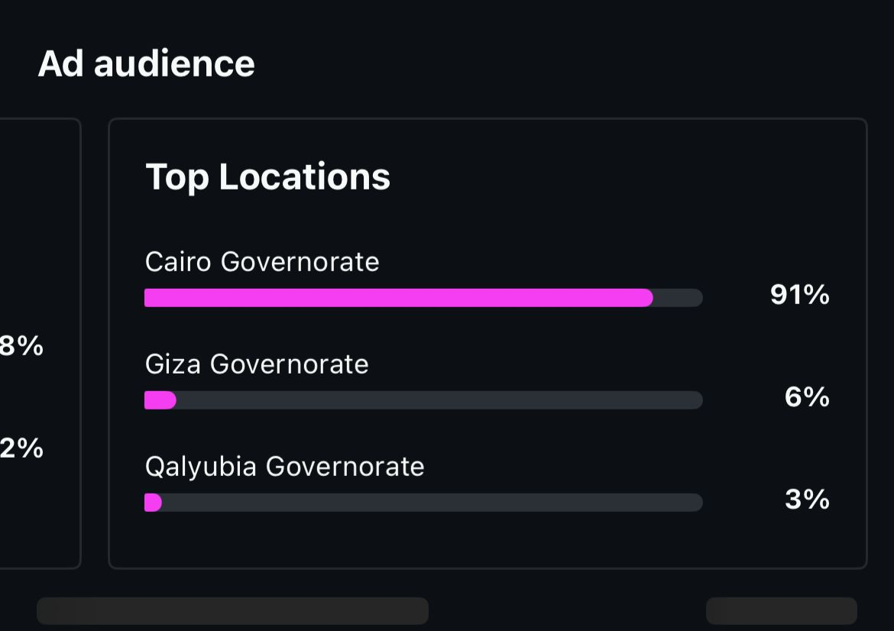
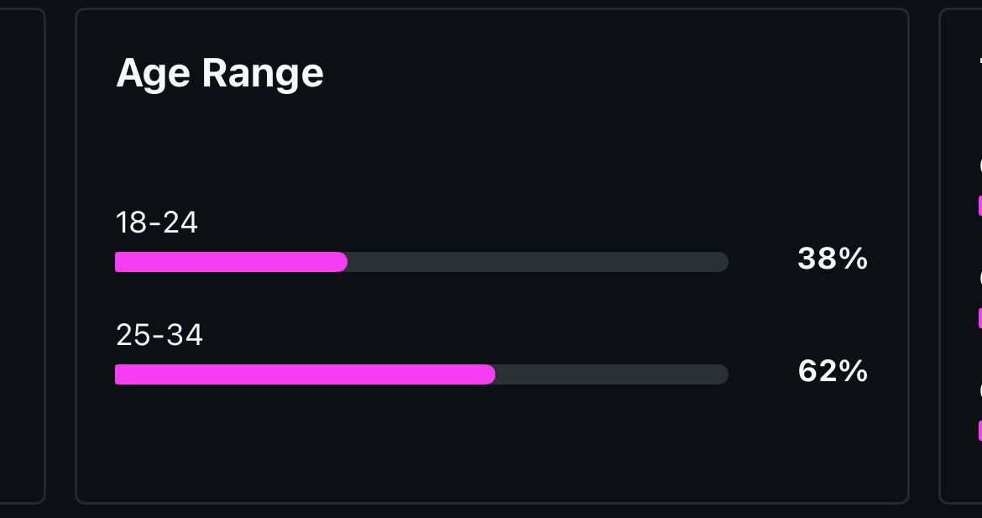

Slide 27
KPI’s for October 2024 - October 2025
Here are KPIs for SMART objectives:
Book 100 clients between October 2024 & October 2025: Track the number of clients booked monthly, aiming for approximately 8-9 clients each month.
Make 1 million profit between October 2024 & October 2025: Monitor monthly profit margins and set a target of roughly 80k-90k profit per month.
Post twice a week on Instagram & Facebook: Measure the frequency of posts weekly, ensuring at least 2 posts each week.
Gain 50,000 followers between October 2024 & October 2025 on Instagram: Track weekly follower growth, aiming for about 960 new followers each week.
Hire a content creator by the end of October: Set a timeline for the hiring process, with specific milestones like job posting, interviews, and selection by mid-October.

Slide 28
Recommendations for ads & content to improve
1. Use Great Photos or Videos: Eye-catching visuals are essential to grab attention and make a strong first impression. They can help convey the atmosphere and quality of your services.
2. Have a Clear Next Step: A straightforward call-to-action, like “Book a Free Consultation,” encourages people to take immediate action and helps turn interest into leads.
3. Target the Right People: Aim your ad at recently engaged couples or people interested in weddings. Reaching the right audience increases the chances of getting inquiries.
4. Show What Makes You Different: Highlight what sets your services apart, like personalized packages or unique themes, to give potential clients a reason to choose you over competitors.

Slide 29

Thank You

